Slide 1
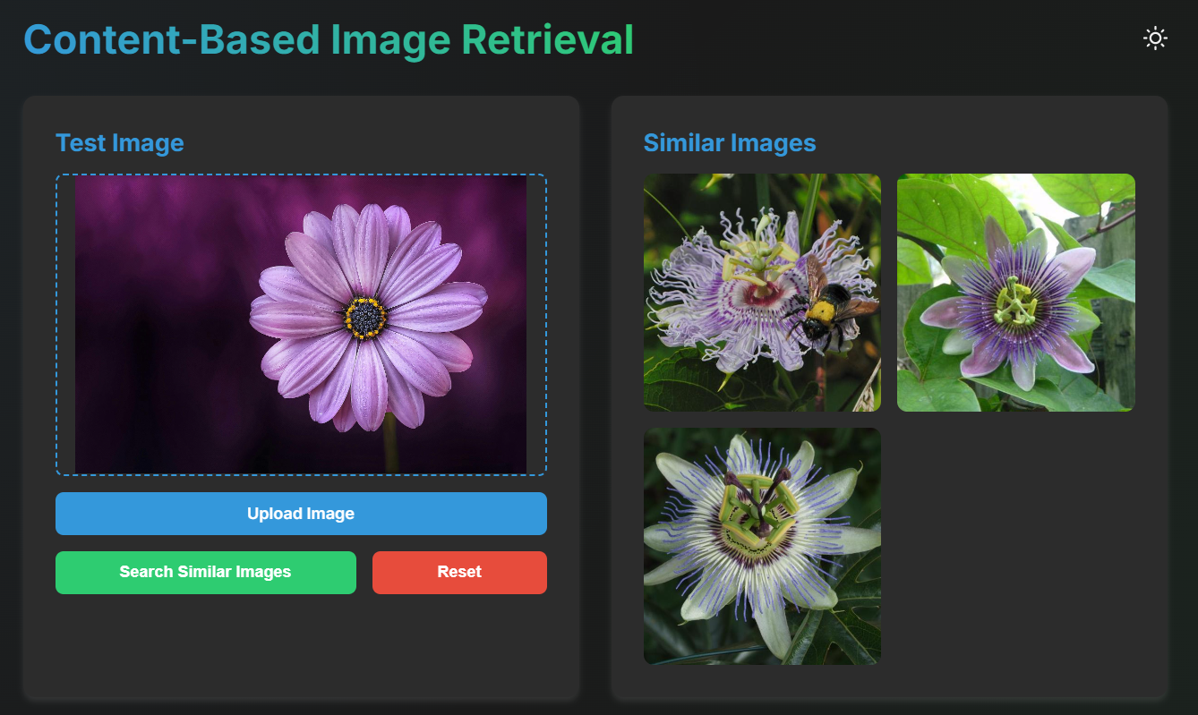
Content-Based Image Retrieval Using Feature Detection
This presentation explores the concept of Content-Based Image Retrieval (CBIR), a powerful technique that utilizes feature detection to search and retrieve images based on their visual content rather than textual descriptions.
Presented By,
Priyanshu Bhardwaj – 220962390
Kirtan Desai – 220962428
Keshav Agrawal - 220962336

Slide 2
Introduction to CBIR
1
Growing Demand
Exponential growth of digital images creates need for efficient retrieval systems.
2
Visual Content Focus
CBIR retrieves images based on visual features rather than text metadata.
3
Feature Extraction
Uses SIFT and ORB descriptors for robust, rotation-invariant feature extraction.

Slide 3

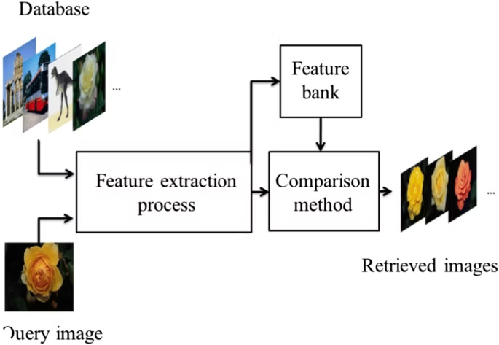
Evolution of CBIR Techniques
Early systems used color, texture, and shape for basic visual analysis.
User input refines search results to bridge the semantic gap.
CNNs extract high-level semantic features for improved accuracy.

Slide 4

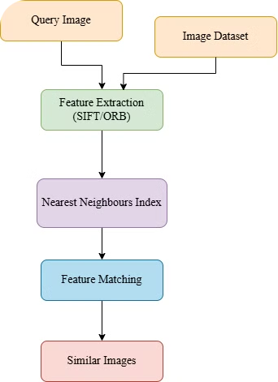
Methodology
1
Preprocessing
Images resized to standard resolution for consistent feature extraction.
2
Feature Extraction
ORB detects key points and computes descriptors for compact representation.
3
Indexing
Feature vectors stored using Nearest Neighbors index for fast retrieval.
4
Query Matching
Query image features compared to indexed vectors using Euclidean distance.

Slide 5

Implementation Details
Technologies
API
Frontend
Python and OpenCV for image processing. Sklearn for nearest neighbor matching.
Flask used to create RESTful API for system interaction.
JavaScript interface for uploading query images and viewing results.

Slide 6
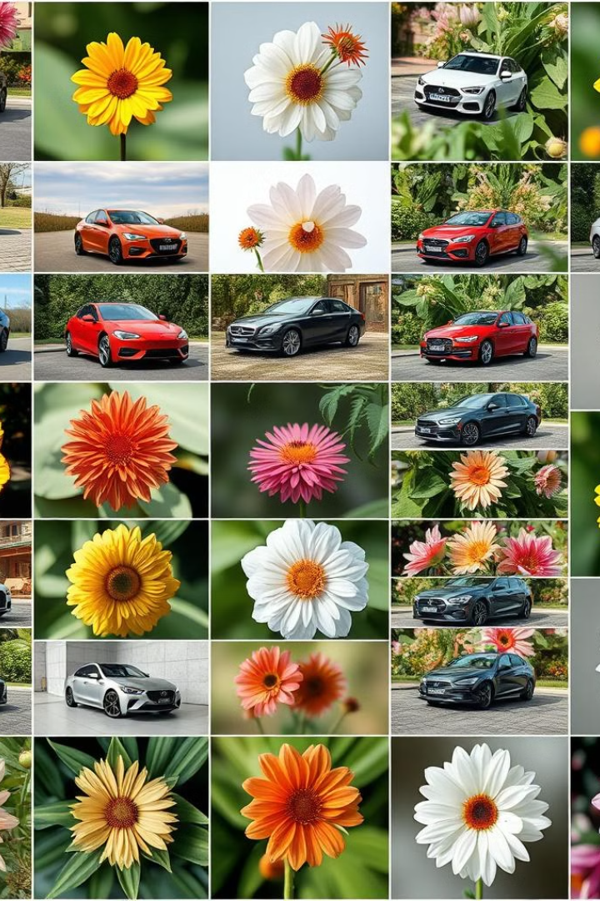
Experimental Results
1
Dataset
200 images (100 per category) of cars and flowers.
2
Retrieval
Top three similar images retrieved from both categories.
3
Performance
High accuracy in classification and retrieval. Average query time: 2.5 seconds.

Slide 7
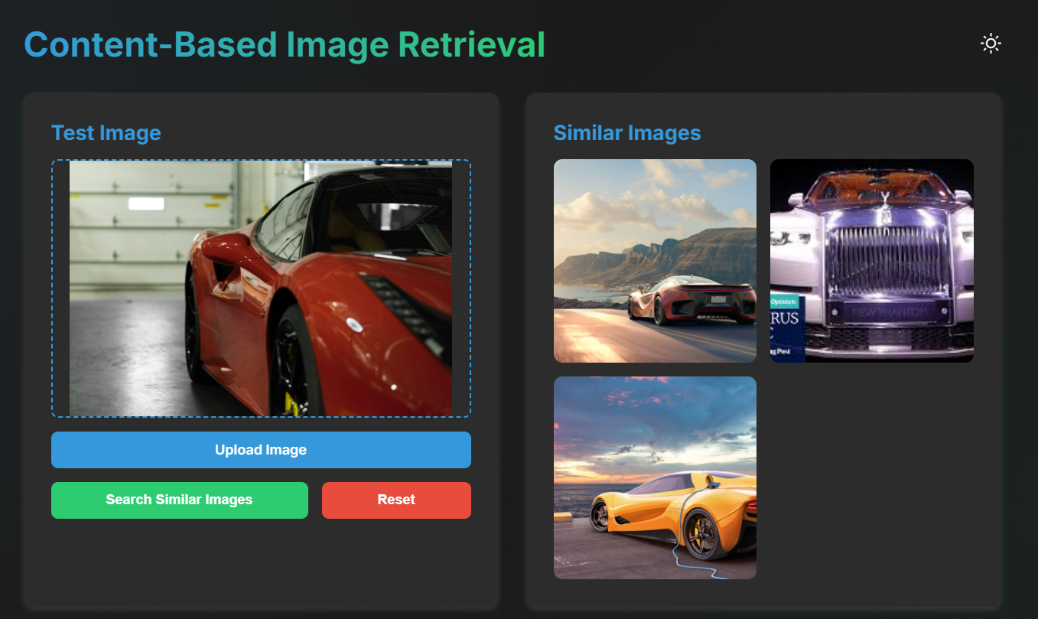
Results

Slide 8
Discussion and Future Work
Efficiency
Scalability
ORB and Nearest Neighbors balance accuracy and computational efficiency.
Brute-force search may limit performance on larger datasets.
Improvements
Deep Learning
Consider ANN algorithms or dimensionality reduction for optimization.
Integrate CNN features to enhance accuracy for complex datasets.

Slide 9
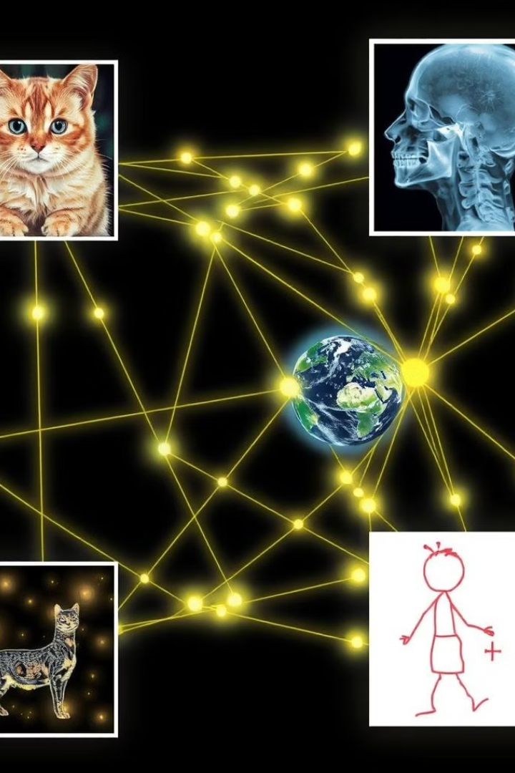



Conclusion
Effective Retrieval
CBIR system demonstrates high accuracy using traditional feature extraction techniques.
Future Potential
Hybrid models combining traditional and deep learning approaches could further enhance performance.
Scalability
Advanced indexing techniques needed for larger datasets and real-time applications.

